Slide 1


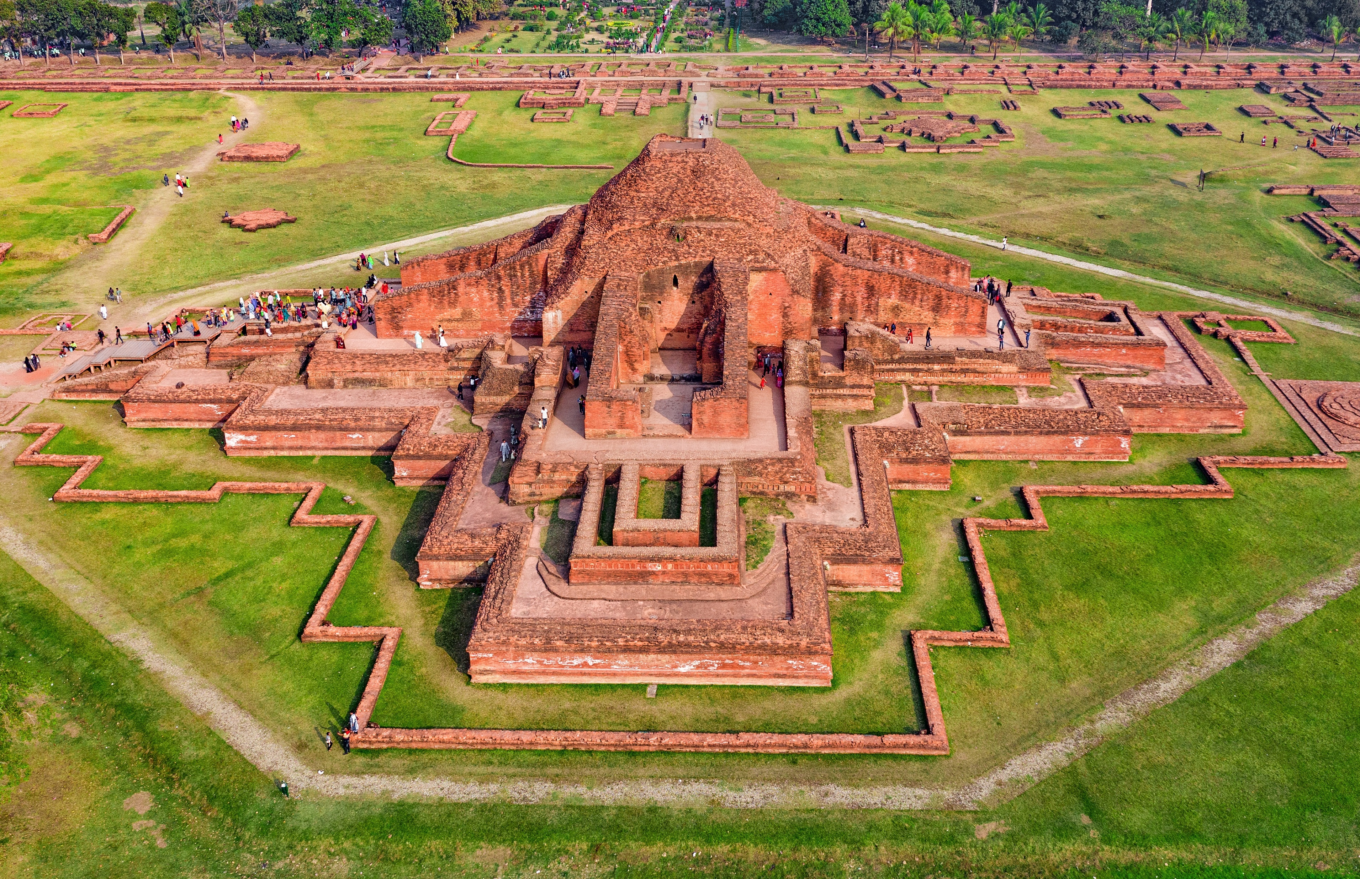



NAOGAON DISTRICT
Presented by
MD. ABU TOWSIF
22-47019-1

Slide 2
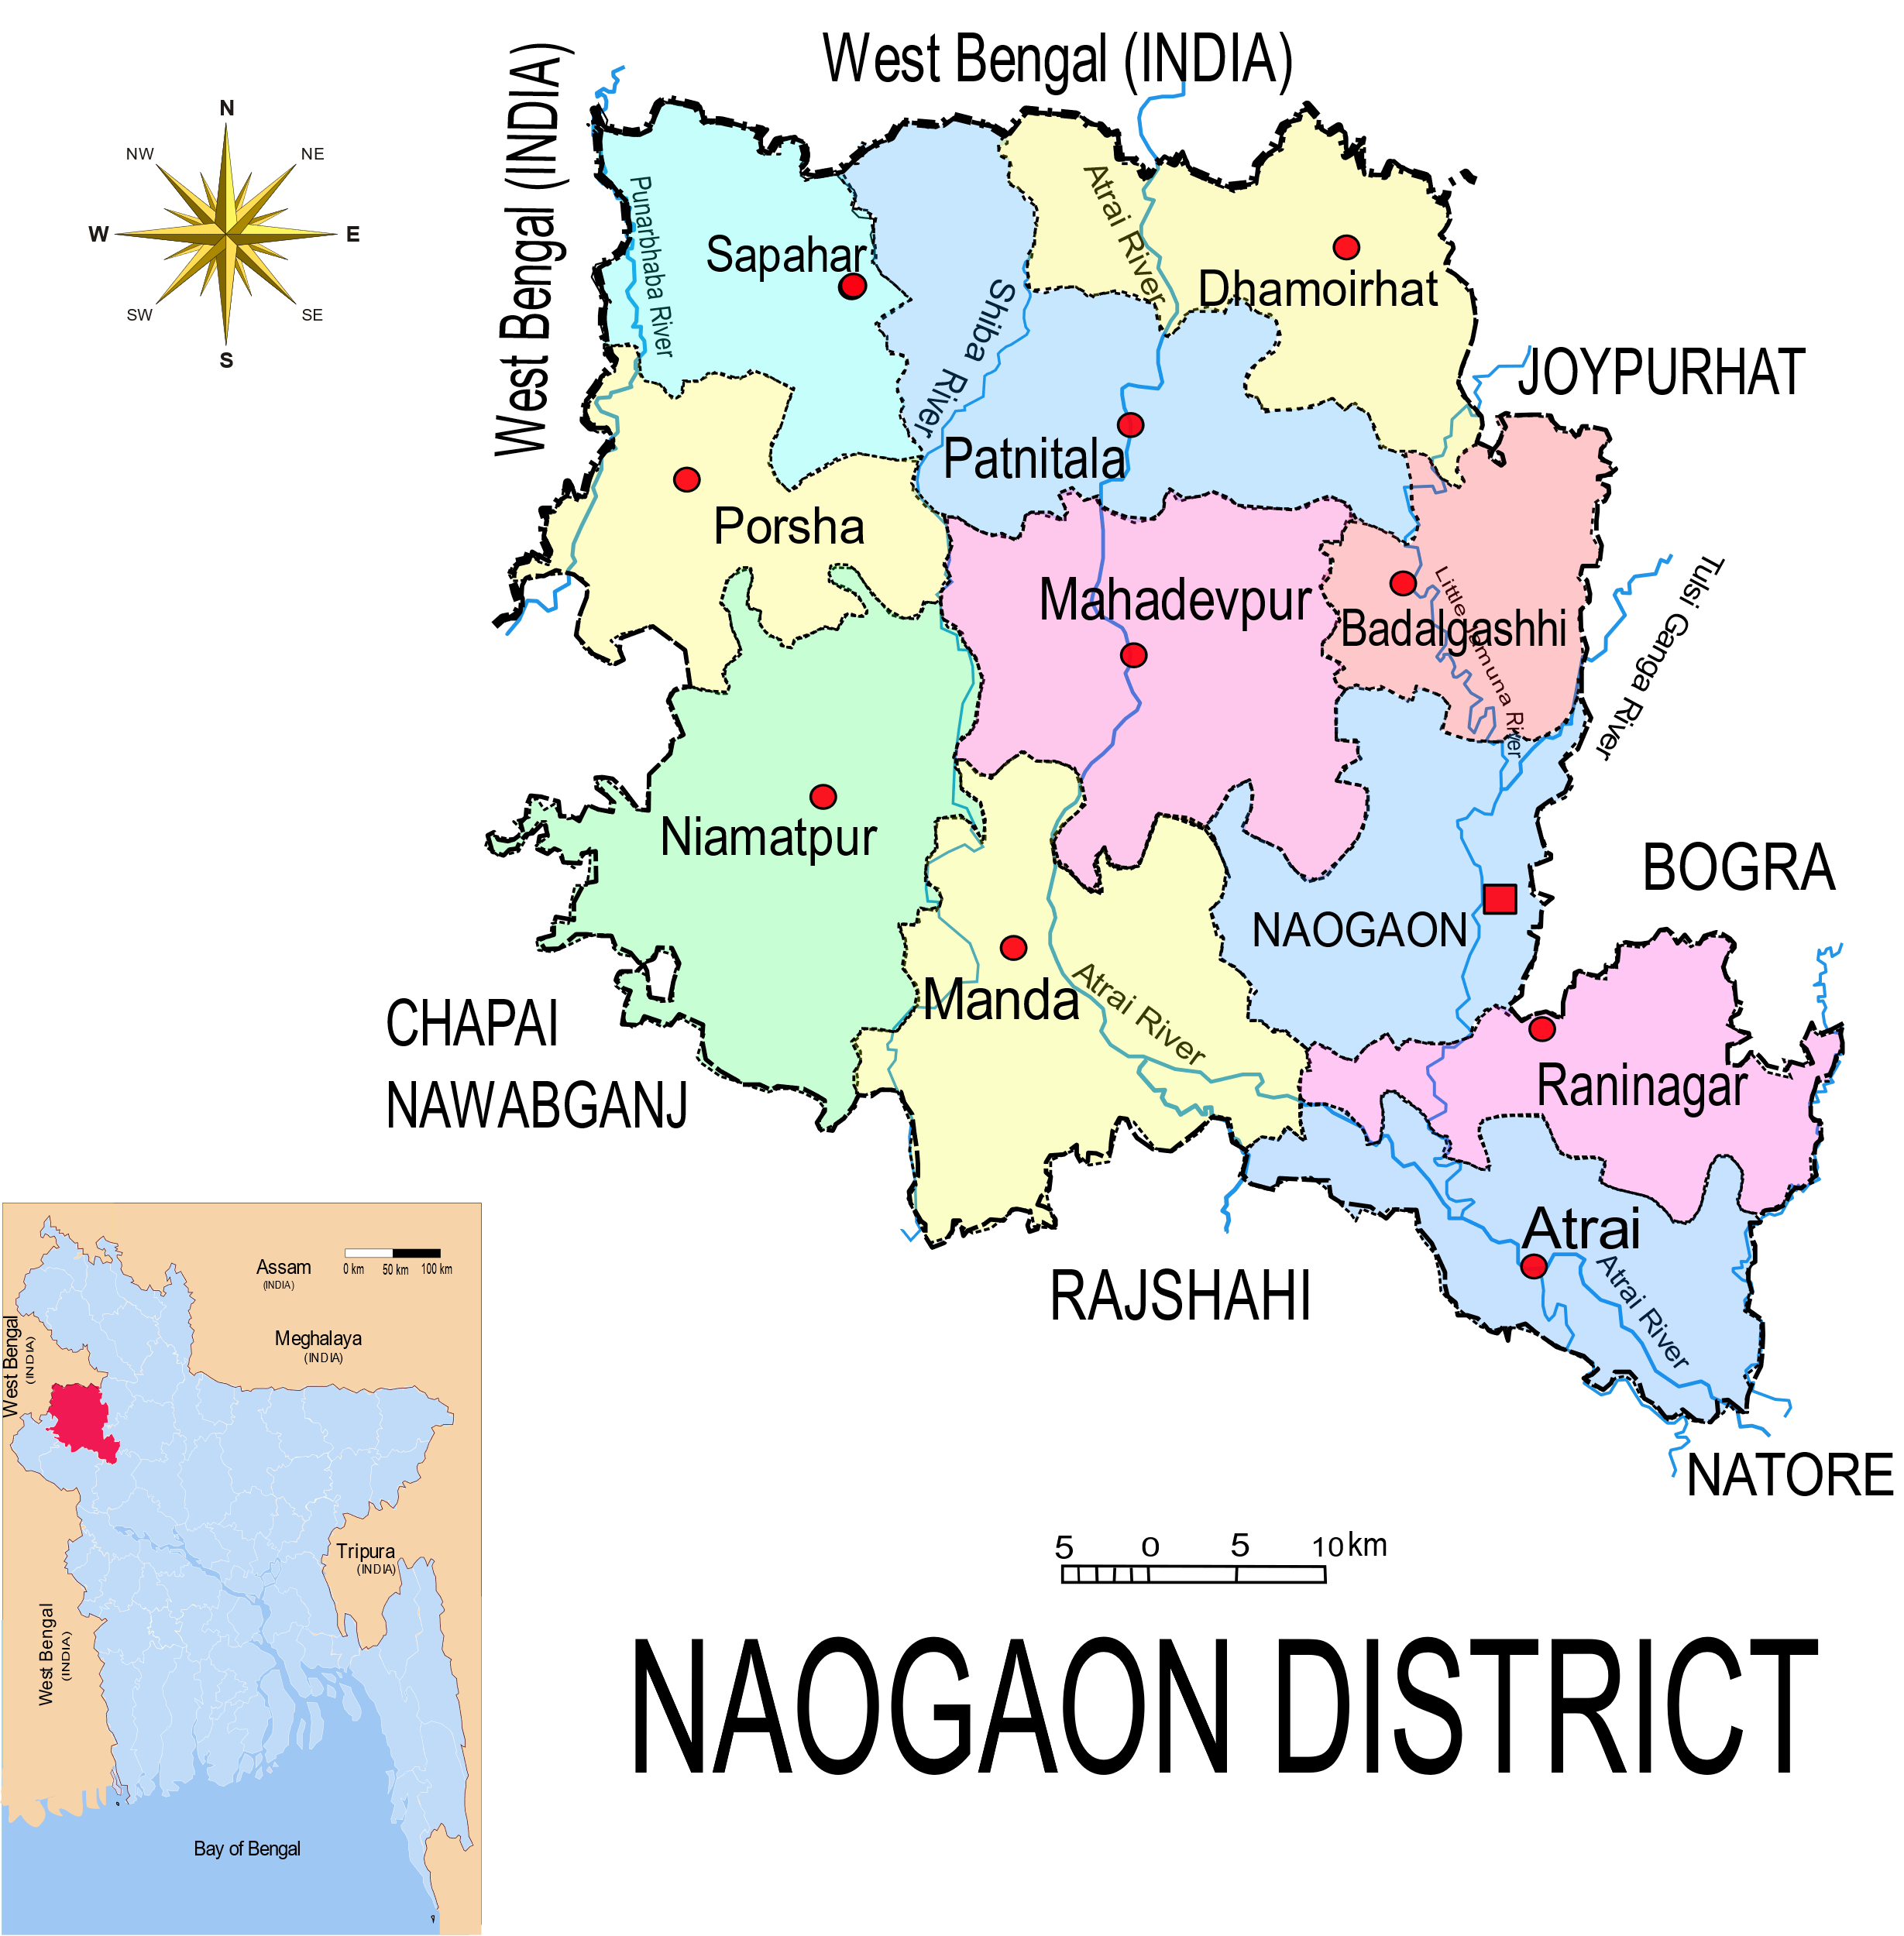
GRAPHICAL LOCATION
In Rajshahi Division
Area of 3435 sq. K.M
Latitude of centre
24.8078° or 24° 48' 28" North
Longitude of centre
88.9462° or 88° 56' 46" East
Bounded by west bengal state of India on the
north, natore and rajshahi districts on the south, joypurhat, bogura and Natore districts on the east, nawabganj district on the west

Slide 3
ADMINISTRATION STRUCTURE
DEVIDED INTO 11 UPAZILAS
Atrai
Badalgachi
Dhamoirhat
Manda
Mohadevpur
Naogaon
Niamatpur
Patnitala
Porsha
Raninagar
Sapahar
Secretary of District Council:
- ATM Abdullahel Baki
Chairman of District Council:
- AKM Foleys Rabbi
Deputy Commissioner (DC):
- Khalid Mehdi Hasan, PAA
Superintendent of Police (SP):
- Md. Iqbal Hossain

Slide 4
POPULATION LITERACY RATE
OTHER
Total population – 2.7 Million
Male -1.3 Million
Female -1.4 Million
Male female ratio 0.92 : 1
literacy rate of 72.14% for the population 7 years and above
HINDU
MUSLIM

Slide 5
ECONOMY
Has predominantly agricultural economy
- Rice, Jute, Wheat, Sugarcane etc.
Is now one of the country’s prime hub for
mango harvest.
- Mangoes are renowned both domestically and
Internationally for their delicious taste
INDUSTRY
SERVICE
21%
AGRICULTURE

Slide 6
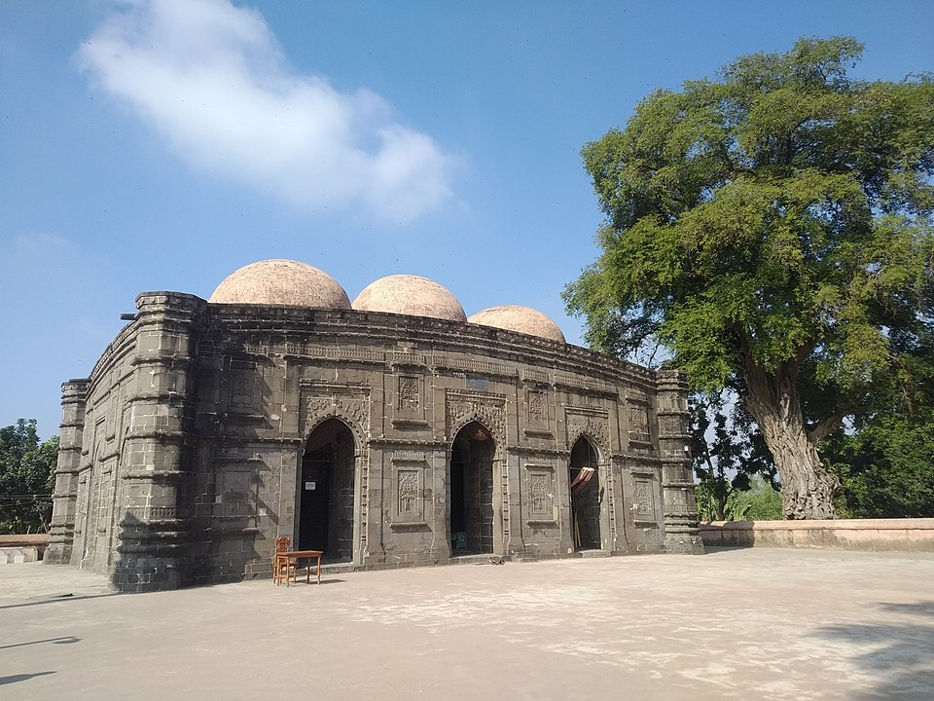
HISTORICAL SITES
Sompura Mahavihara
- Designated as a UNESCO world heritage site in 1985
Kushumba Mosque
- Nicknamed as “ The Black Gem of Bangladesh”

Slide 7
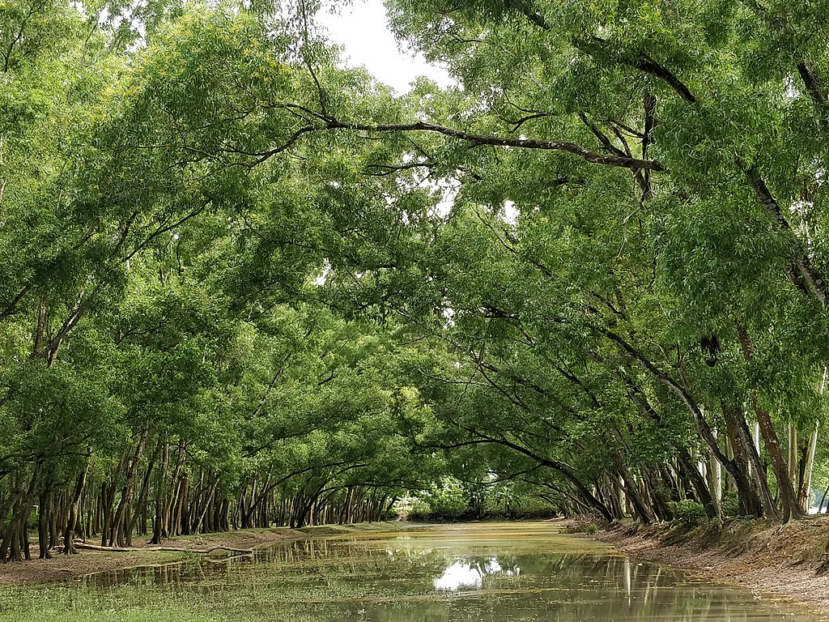
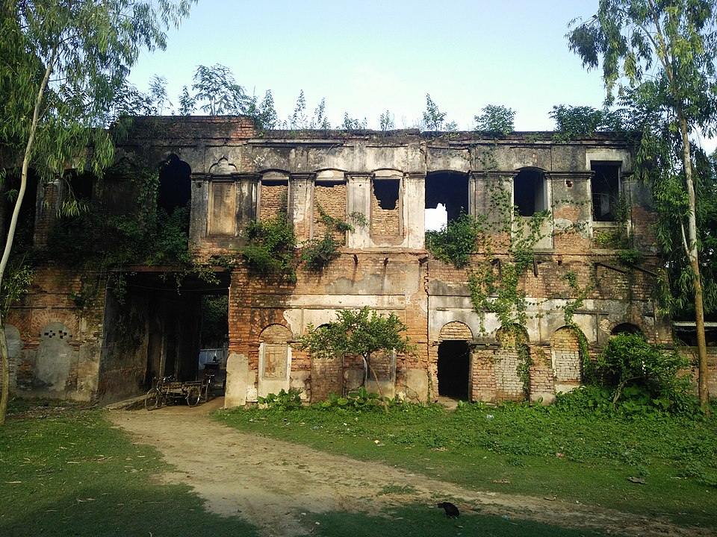
OTHER TOURIST SPOTS
Altadighi national park
- Dhamoirhat upazilla
- 56 K.M. apart from Zilla sadar
Bolihar Rajbari
- Mohadevpur upazilla.
- 20 K.M apart from zilla sadar

Slide 8
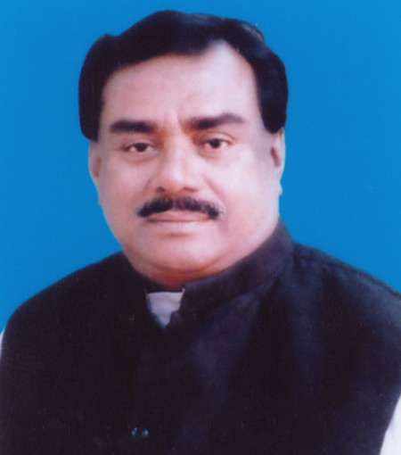
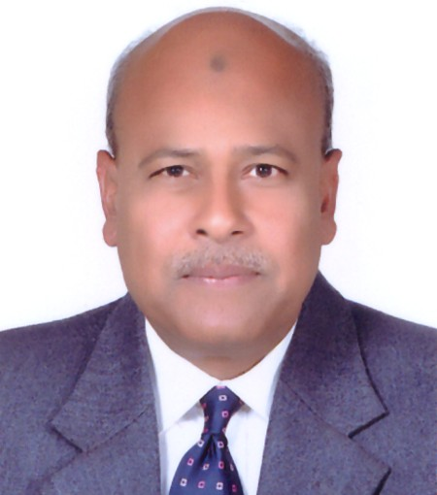
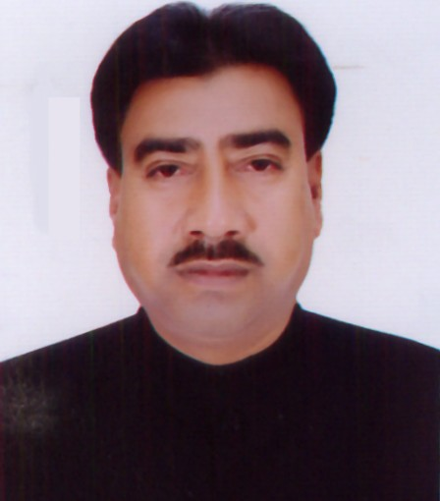
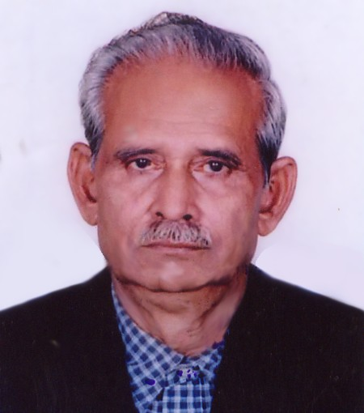
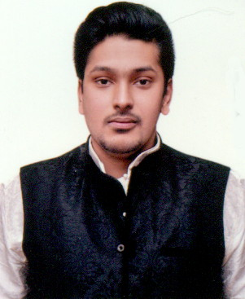
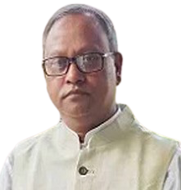
POLITICAL LEADERS (MP)
Sadhan Chandra Majumder
- Naogaon 1
Md. Shahiduzzaman Sarker
- Naogaon 2
Mohammad Salim Uddin Tarafdar
- Naogaon 3
Md. Emad Uddin Pk
- Naogaon 4
Nizam Uddin Jalil John
- Naogaon 5
Md. Anwar Hossain
- Naogaon 6
All of them are from Bangladesh Awami League

Slide 9
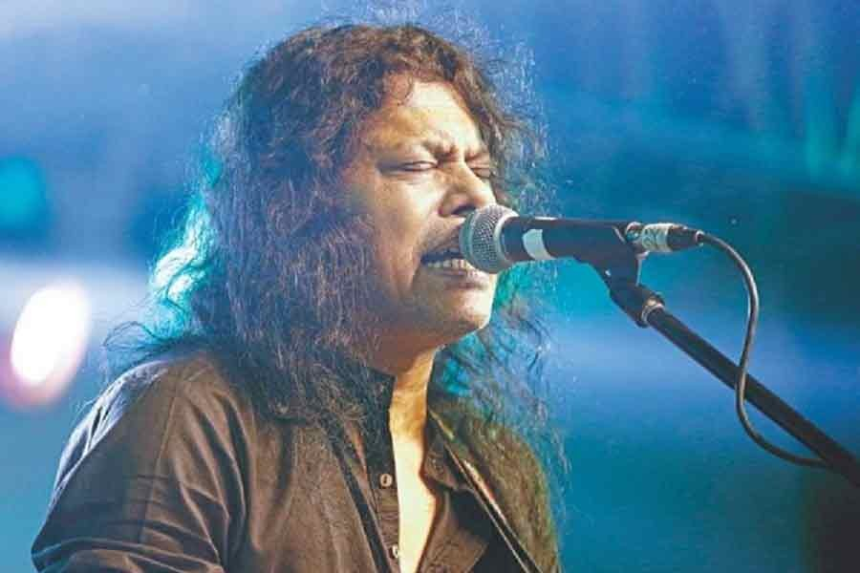
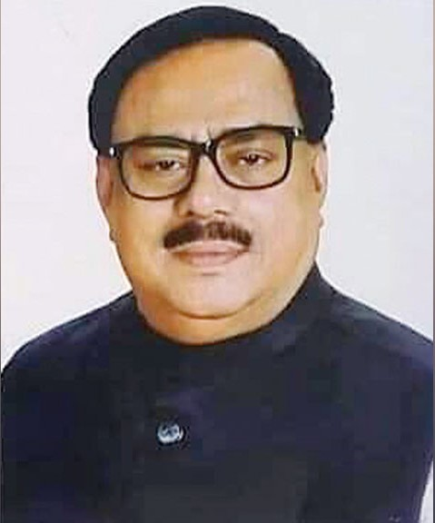
RENOWNED PERSONALITIES
James
- Also known as “Nagar Baul”. He was born
and raised in Naogaon
Enamul Haque
- Footballer
Sadhan Chandra Majumder
- Minister of food
Mohammad Baitullah
- First deputy speaker of Bangladesh Parliament

Slide 10
CONCLUSION
Combines historical significance, agricultural prosperity and natural charm making it an interesting and culturally vibrant part of Bangladesh
Showcases a rich cultural heritage, natural beauty, and immense potential for economic development
Its archaeological treasures, cultural heritage, and agricultural significance make it a district worth exploring and investing in

Slide 11
THANK YOU
Thank you all for taking the time to explore my beloved district, Naogaon. As I conclude this presentation, I would like to express my sincere gratitude for your attention and engagement.
Lastly, I can assure you that ,Naogaon can be a potential travel destination for all of us. By choosing to visit my district, you will not only contribute to the local economy but also get to witness the vibrant spirit and resilience of our community.

